Slide 1
interim - Drone For Your Safety
Presented by: Yuval Pery, Rachel Sade and Shaked Horesh

Slide 2
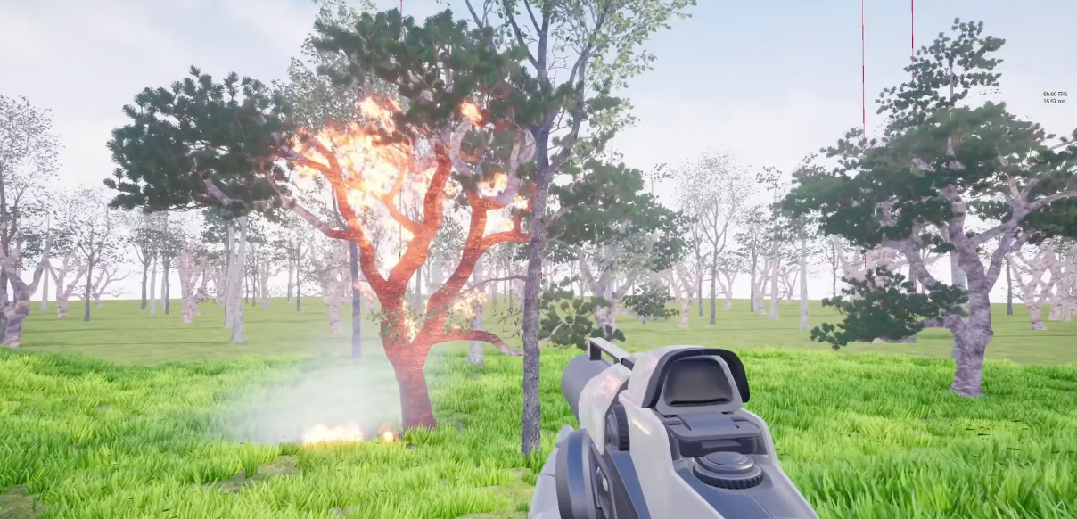
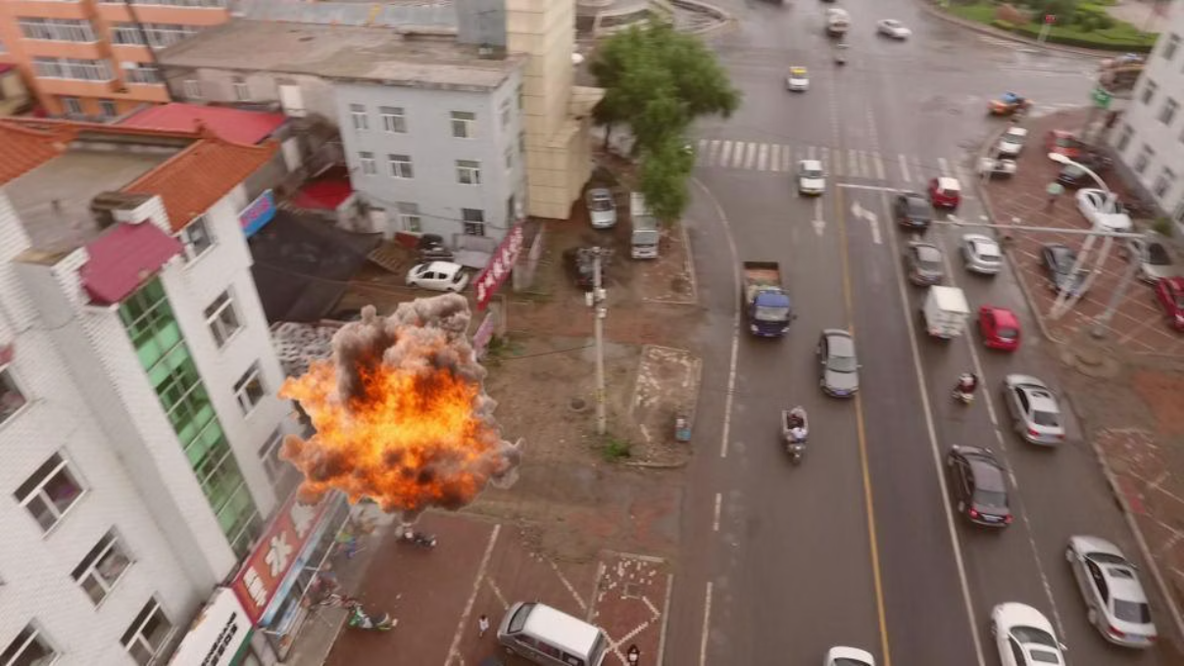
Project Review
Motivation
Specifications
Novelty
Changes from proposal
The critical scarcity and high risk involved in collecting real-world drone footage of humans trapped in active wildfires.
A YOLOv8 object detection model trained on a dataset, generated by a Python script that injects synthetic fire and atmospheric effects into real imagery with automatic labeling.
This project introduces a novel 2D data augmentation pipeline that synthesizes extreme fire and smoke scenarios, enabling the training of Search and Rescue drones to detect victims in low-visibility environments without hazardous data collection or complex 3D engines.
we decided to use a data set from ROBOFLOW instead of generating with CARLA
We decided to focus on generating specifically fire and smoke.

Slide 3
Previous Work
title/year
task
methods
data
results
relation to our project
Understanding the Impact of Image Quality and Distance of Objects to Object Detection Performance (2023)
Analyzing how image resolution, compression, and object distance affect detection accuracy and costs.
Tested spatial resizing and JPEG compression levels: evaluated optimal resolutions for constrained bandwidth/ storage.
A custom dataset created by combining the TJU and Eurocity datasets with varying resolutions.
Proved that higher spatial resolution significantly enables a greater detection range for distant objects.
Provides scientific proof that reducing quality (like our 2D/ compression pipeline) is a valid trade-off for drone storage.
Robustness Analysis of Object Detection Models under Weather Degradation (2025)
Analyze how image quality degradation (noise, blur, reduced resolution, weather effects) impacts object detection performance.
Evaluation of object detection models (including YOLO) under controlled image degradations such as blur, noise, and fog, combined with data augmentation experiments.
Real-world adverse weather datasets and synthetically degraded images simulating realistic visual conditions.
The study shows that image degradation significantly reduces detection accuracy, while training with degraded and augmented images improves model robustness and generalization.
Provides scientific evidence that training on degraded images (blur, noise, reduced resolution) improves object detection robustness under real-world adverse conditions.

Slide 4
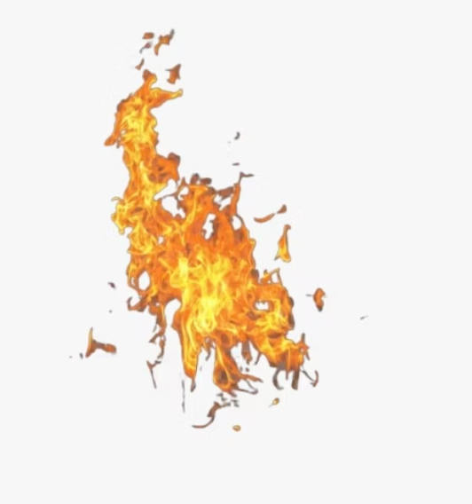
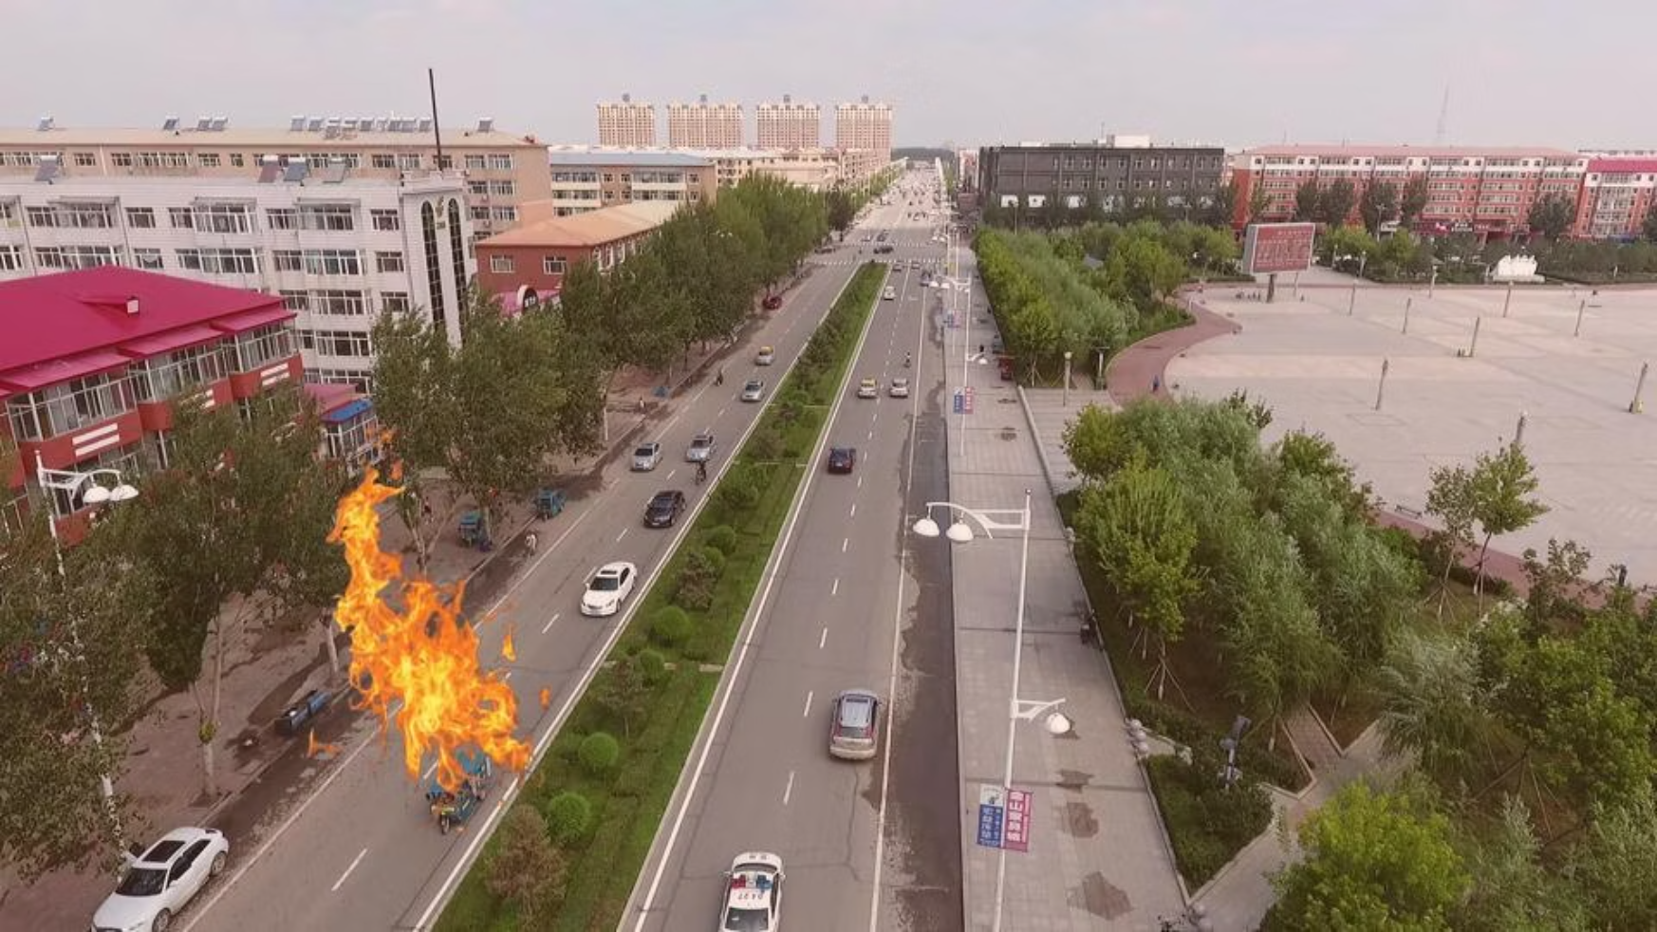
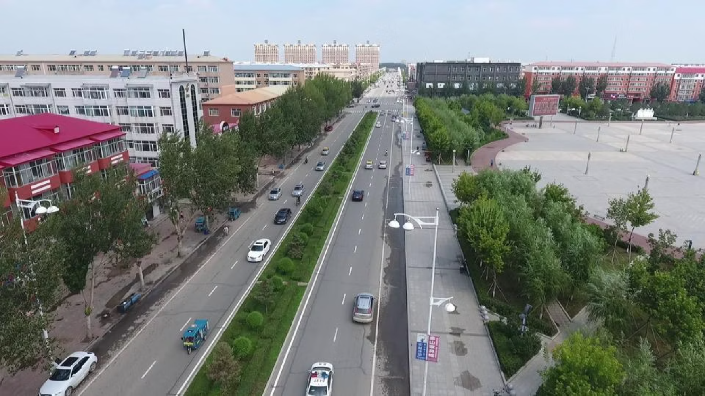
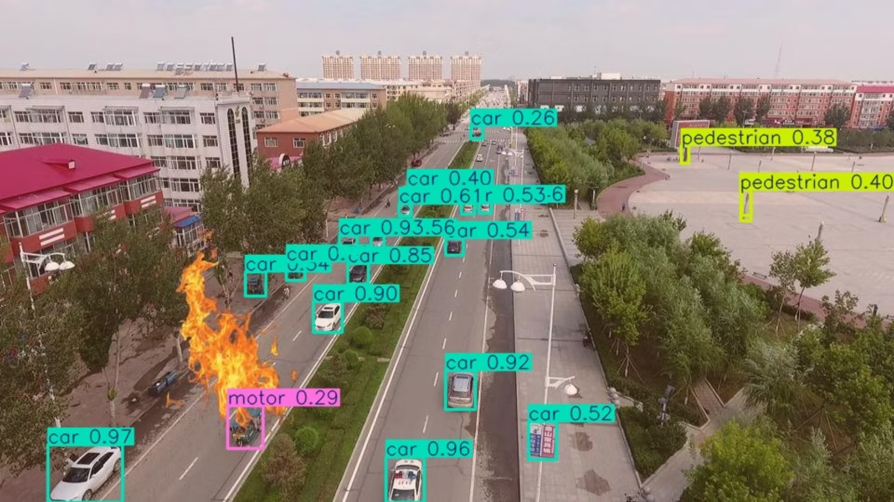
Dataset
before
after

Slide 5
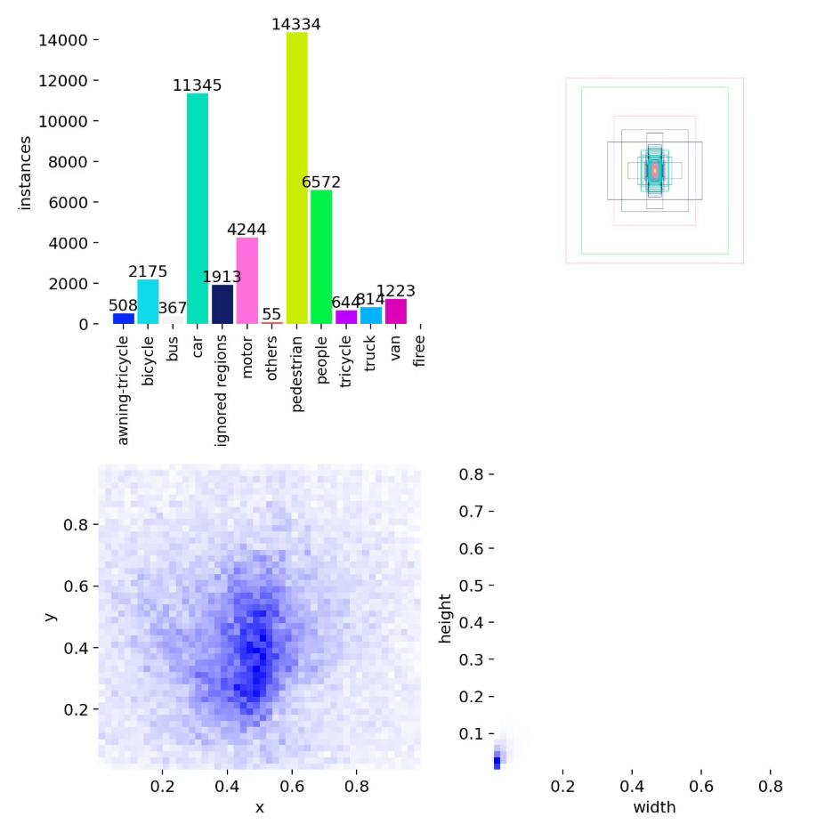
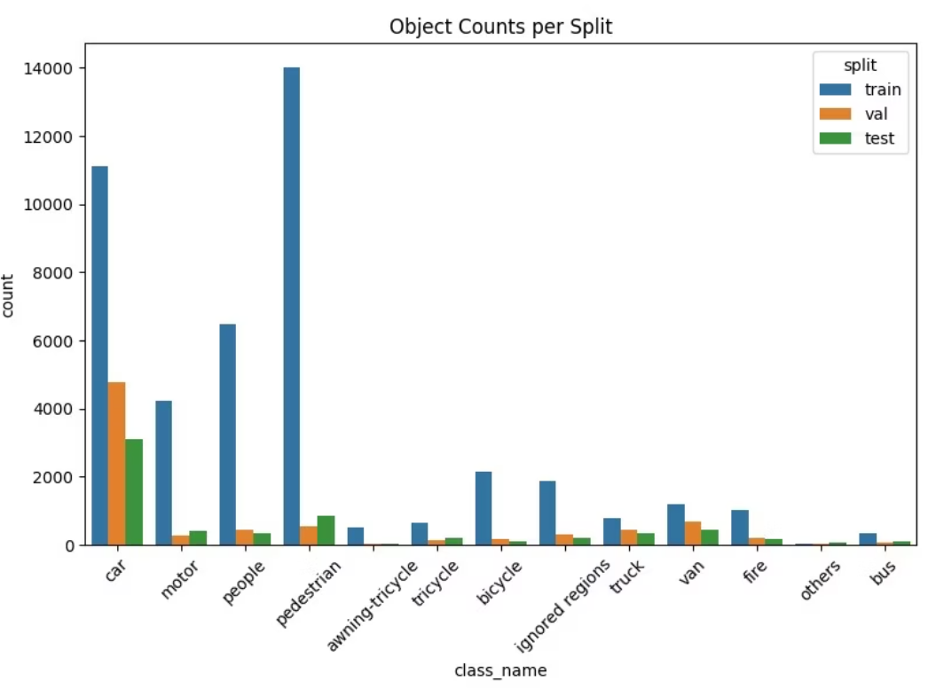
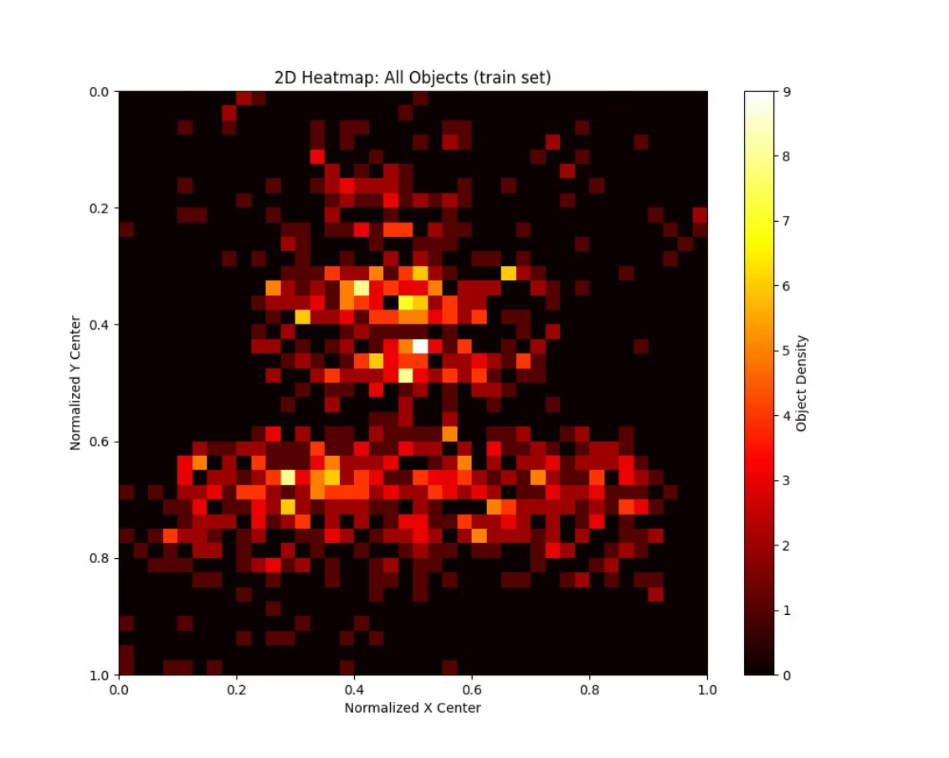
Baseline solution and results

Slide 6
Plan
Apply stratified splitting to ensure consistent class distribution across sets and prevent model evaluation bias using scikit-learn
To decrease the quality of the fire images
Generating the rest of the dataset and train it
Make sure the fire is spread across the entire width of the image
Generating 10% of the train dataset with ControlNet in order to enhances the dataset's photorealism
Evaluation of the final dataset

Slide 7
Thank you

